Slide 1
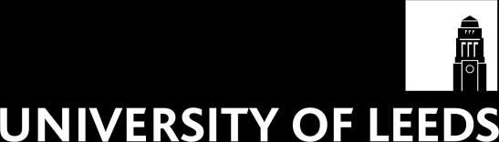
School of E&EE
FACULTY OF ENGINEERING
Data Communications and Network Security
ELEC5471M
Section 2. The Internet.

Slide 2
Data Communications and Network Security
Learning Objectives To provide students with a knowledge and understanding of data communications and wireless sensor networks and how they are, and could be, used in a range of applications. (See module catalogue).
I will cover these objectives by:
Introductory lecture and the ISO/OSI 7-layer protocol architecture.
The Internet and the TCP/IP architecture.
You will examine the transport layer and in particular TCP and UDP.
Examining the way in which security can be provided across networks will be considered.
We’ll consider the functions of the network layer and IP.
We will develop methods of sharing a common transmission medium (MAC).

Slide 3
Data Communications and Network Security
What must you contribute?
Lectures will be the basic provision of material but YOUR private study is also required.
Also you need to do the web examples suggested, you need to read from all the advised texts and consult the other suggested texts.
You must spend time before each lecture preparing yourself for what the lecture will be about and after each lecture going over the content and checking your understanding.
The Assessment of the module:
Will check you have all met the learning objectives.
Will grade to what extent you have exceeded the objectives.
The exam questions I set will be on:
The layered protocol architectures (ISO and TCP/IP).
The transport layer and sessions across a network, TCP & UDP operation (including congestion control).
Network layer issues (including addressing and routing).
Link layer issues (e.g. MAC).
There will also be a project on the security aspects.

Slide 4
Data Communications and Network Security ELEC5471M
To be given by:
Prof A. H. Kemp & Dr M. Rasavi
Possibly with support from experts studying in the field.
Assessment will be by 1 exam of 2 hours duration and a Project.
Advised texts:
Computer Networking by Kurose and Ross ISBN:0201976994
Protocols and architectures for wireless sensor networks by Holger, K. and Willig, A. Hoboken, NJ : Wiley, 2007, c2005.
Computer Networks, by Tanenbaum ISBN:0133499456
Multimedia communications by Halsall ISBN:0201398184
Also for general reading:
Data & Computer Communications, by Stallings ISBN:0135712742

Slide 5
The Transport Layer.
-Purpose of transport layer.
-Basic transport primitives.
Tanenbaum: Chapter 6,
Kurose & Ross: Chapter 3,
Stallings (7th Ed): Chapter 20.

Slide 6
Objective of this section
To establish the purpose of the transport layer.
To understand and be able to use the basic transport primitives.
See function of layered protocols.
Develop understanding of more advanced systems.

Slide 7
Transport layer; context
Application
Presentation
Session
Transport
Network
Data Link
Physical
Not present in TCP/IP model.
Within TCP/IP structure it takes PDU from the application and passes it down to the network layer.

Slide 8
The Transport layer
The heart of the whole protocol structure.
The ultimate goal of the transport layer is to provide efficient, reliable, and cost effective services to its users (i.e. the processes in the application layer).
The software (or theoretically hardware) of the transport entity can be in:
Operating system kernel,
A separate user process,
A library package in network applications,
The network interface card.

Slide 9
The Transport layer

Slide 10
Transport services and protocols
provide logical communication between application processes running on different hosts
transport protocols run in end systems
tx side: breaks app messages into segments, passes to network layer
rx side: reassembles segments into messages, passes to app layer
more than one transport protocol available to apps
Internet: TCP and UDP
application
transport
network
data link
physical
network
data link
physical
network
data link
physical
network
data link
physical
logical end-end transport
network
data link
physical
network
data link
physical
application
transport
network
data link
physical

Slide 11
Transport vs. network layer
network layer: logical communication between hosts
transport layer: logical communication between processes
relies on, enhances, network layer services
Household analogy:
12 kids sending letters to 12 kids
processes = kids
app messages = letters in envelopes
hosts = houses
transport protocol = Ann and Bill
network-layer protocol = postal service

Slide 12
Internet transport-layer protocols
reliable, in-order delivery: TCP
congestion control
flow control
connection setup
unreliable, unordered delivery: UDP
no-frills extension of “best-effort” IP
services not available:
delay guarantees
bandwidth guarantees
application
transport
network
data link
physical
network
data link
physical
network
data link
physical
network
data link
physical
logical end-end transport
network
data link
physical
network
data link
physical
application
transport
network
data link
physical

Slide 13
The Transport layer
Makes it possible for the transport service to be more reliable than the underlying network service.
Lost and damaged packets can be detected and compensated for.
Can consider transport layer as enhancing the quality of service provided by the network layer.
The service primitives can be independent of the network primitives (which may vary from network to network).
Hence applications programs can be written with a standard set of primitives.

Slide 14
The Transport layer
ISO:
Defines five transport protocol standards, each oriented towards a different underlying service.
TCP/IP:
Two common transport layer standards, the connection oriented TCP and the connectionless UDP.
UDP: Multiplexing, Integrity check.
TCP: Multiplexing, Integrity check, Flow control, Sequencing, Acknowlegements, Timers and Congestion control.

Slide 15
Section outline
Transport-layer services
Principles of reliable data transfer
Primitives.
Internet file server example.

Slide 16
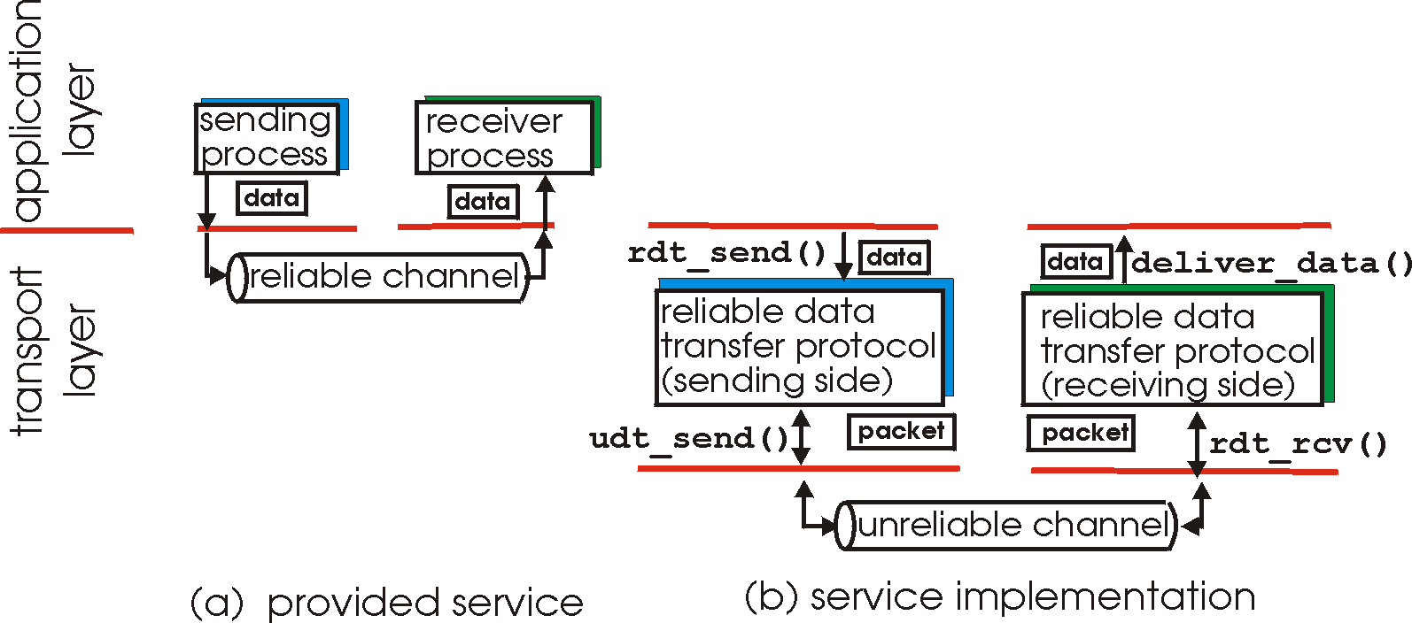
Principles of Reliable data transfer
important in application, transport, link layers
top-10 list of important networking topics!
characteristics of unreliable channel will determine complexity of reliable data transfer protocol (rdt)

Slide 17
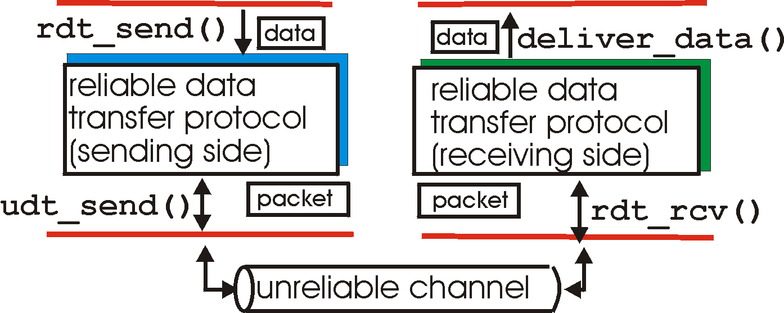
Reliable data transfer: getting started
rdt_send(): called from above, (e.g., by app.). Passed data to
deliver to receiver upper layer
deliver_data(): called by rdt to deliver data to upper
send
side
receive
side
udt_send(): called by rdt,
to transfer packet over
unreliable channel to receiver
rdt_rcv(): called when packet arrives on rcv-side of channel

Slide 18
Reliable data transfer: getting started
We’ll:
incrementally develop sender, receiver sides of reliable data transfer protocol (rdt)
consider only unidirectional data transfer
but control info. will flow in both directions!
use finite state machines (FSM) to specify sender, receiver
event causing state transition
actions taken on state transition
state: when in this “state” next state uniquely determined by next event
state
1
state
2
event
actions

Slide 19
Rdt1.0: reliable transfer over a reliable channel
underlying channel perfectly reliable
no bit errors
no loss of packets
separate FSMs for sender, receiver:
sender sends data into underlying channel
receiver read data from underlying channel
Wait for call from above
rdt_send(data)
Wait for call from below
rdt_rcv(packet)
extract (packet,data)
deliver_data(data)
packet = make_pkt(data)
udt_send(packet)
sender
receiver

Slide 20
Rdt2.0: channel with bit errors
underlying channel may flip bits in packet
recall: UDP checksum to detect bit errors
the question: how to recover from errors:
acknowledgements (ACKs): receiver explicitly tells sender that pkt received OK
negative acknowledgements (NAKs): receiver explicitly tells sender that pkt had errors
sender retransmits pkt on receipt of NAK
human scenarios using ACKs, NAKs?
new mechanisms in rdt2.0 (beyond rdt1.0):
error detection
receiver feedback: control msgs (ACK,NAK) rcvr->sender

Slide 21
rdt2.0: FSM specification
rdt_send(data)
sndpkt = make_pkt(data, checksum)
udt_send(sndpkt)
receiver
rdt_rcv(rcvpkt) &&
isNAK(rcvpkt)
Wait for call from above
Wait for ACK or NAK
rdt_rcv(rcvpkt) &&
corrupt(rcvpkt)
udt_send(sndpkt)
udt_send(NAK)
rdt_rcv(rcvpkt) && isACK(rcvpkt)
Λ
Wait for call from below
sender
rdt_rcv(rcvpkt) &&
notcorrupt(rcvpkt)
extract(rcvpkt,data)
deliver_data(data)
udt_send(ACK)

Slide 22
rdt2.0: operation with no errors
rdt_send(data)
sndpkt = make_pkt(data, checksum)
udt_send(sndpkt)
rdt_rcv(rcvpkt) &&
isNAK(rcvpkt)
Wait for call from above
Wait for ACK or NAK
rdt_rcv(rcvpkt) &&
corrupt(rcvpkt)
udt_send(sndpkt)
udt_send(NAK)
rdt_rcv(rcvpkt) && isACK(rcvpkt)
Wait for call from below
Λ
rdt_rcv(rcvpkt) &&
notcorrupt(rcvpkt)
extract(rcvpkt,data)
deliver_data(data)
udt_send(ACK)

Slide 23
rdt2.0: error scenario
rdt_send(data)
sndpkt = make_pkt(data, checksum)
udt_send(sndpkt)
rdt_rcv(rcvpkt) &&
isNAK(rcvpkt)
Wait for call from above
Wait for ACK or NAK
rdt_rcv(rcvpkt) &&
corrupt(rcvpkt)
udt_send(sndpkt)
udt_send(NAK)
rdt_rcv(rcvpkt) && isACK(rcvpkt)
Wait for call from below
Λ
rdt_rcv(rcvpkt) &&
notcorrupt(rcvpkt)
extract(rcvpkt,data)
deliver_data(data)
udt_send(ACK)

Slide 24
rdt2.0 has a fatal flaw!
What happens if ACK/NAK corrupted?
sender doesn’t know what happened at receiver!
can’t just retransmit: possible duplicate
What to do?
sender ACKs/NAKs receiver’s ACK/NAK? What if sender ACK/NAK lost?
retransmit, but this might cause retransmission of correctly received pkt!
Handling duplicates:
sender adds sequence number to each pkt
sender retransmits current pkt if ACK/NAK garbled
receiver discards (doesn’t deliver up) duplicate pkt
stop and wait
Sender sends one packet,
then waits for receiver
response

Slide 25
rdt2.1: sender, handles garbled ACK/NAKs
rdt_send(data)
sndpkt = make_pkt(0, data, checksum)
udt_send(sndpkt)
rdt_rcv(rcvpkt) &&
( corrupt(rcvpkt) ||
isNAK(rcvpkt) )
Wait for call 0 from above
Wait for ACK or NAK 0
udt_send(sndpkt)
rdt_rcv(rcvpkt)
&& notcorrupt(rcvpkt)
&& isACK(rcvpkt)
rdt_rcv(rcvpkt)
&& notcorrupt(rcvpkt)
&& isACK(rcvpkt)
Λ
Λ
Wait for ACK or NAK 1
Wait for
call 1 from above
rdt_rcv(rcvpkt) &&
( corrupt(rcvpkt) ||
isNAK(rcvpkt) )
rdt_send(data)
udt_send(sndpkt)
sndpkt = make_pkt(1, data, checksum)
udt_send(sndpkt)

Slide 26
rdt2.1: receiver, handles garbled ACK/NAKs
rdt_rcv(rcvpkt) && notcorrupt(rcvpkt)
&& has_seq0(rcvpkt)
extract(rcvpkt,data)
deliver_data(data)
sndpkt = make_pkt(ACK, chksum)
udt_send(sndpkt)
rdt_rcv(rcvpkt) && corrupt(rcvpkt)
rdt_rcv(rcvpkt) && corrupt(rcvpkt)
sndpkt = make_pkt(NAK, chksum)
udt_send(sndpkt)
sndpkt = make_pkt(NAK, chksum)
udt_send(sndpkt)
Wait for
0 from below
Wait for
1 from below
rdt_rcv(rcvpkt) &&
not corrupt(rcvpkt) &&
has_seq1(rcvpkt)
rdt_rcv(rcvpkt) &&
not corrupt(rcvpkt) &&
has_seq0(rcvpkt)
sndpkt = make_pkt(ACK, chksum)
udt_send(sndpkt)
sndpkt = make_pkt(ACK, chksum)
udt_send(sndpkt)
rdt_rcv(rcvpkt) && notcorrupt(rcvpkt)
&& has_seq1(rcvpkt)
extract(rcvpkt,data)
deliver_data(data)
sndpkt = make_pkt(ACK, chksum)
udt_send(sndpkt)

Slide 27
rdt2.1: discussion
Sender:
seq # added to pkt
two seq. #’s (0,1) will suffice. Why?
must check if received ACK/NAK corrupted
twice as many states
state must “remember” whether “current” pkt has 0 or 1 seq. #
Receiver:
must check if received packet is duplicate
state indicates whether 0 or 1 is expected pkt seq #
note: receiver can not know if its last ACK/NAK received OK at sender

Slide 28
rdt2.2: a NAK-free protocol
same functionality as rdt2.1, using ACKs only
instead of NAK, receiver sends ACK for last pkt received OK
receiver must explicitly include seq # of pkt being ACKed
duplicate ACK at sender results in same action as NAK: retransmit current pkt

Slide 29
rdt2.2: sender, receiver fragments
rdt_send(data)
sndpkt = make_pkt(0, data, checksum)
udt_send(sndpkt)
rdt_rcv(rcvpkt) &&
( corrupt(rcvpkt) ||
isACK(rcvpkt,1) )
Wait for call 0 from above
Wait for ACK
0
udt_send(sndpkt)
sender FSM
fragment
rdt_rcv(rcvpkt)
&& notcorrupt(rcvpkt)
&& isACK(rcvpkt,0)
rdt_rcv(rcvpkt) &&
(corrupt(rcvpkt) ||
has_seq1(rcvpkt))
Λ
Wait for
0 from below
receiver FSM
fragment
udt_send(sndpkt)
rdt_rcv(rcvpkt) && notcorrupt(rcvpkt)
&& has_seq1(rcvpkt)
extract(rcvpkt,data)
deliver_data(data)
sndpkt = make_pkt(ACK1, chksum)
udt_send(sndpkt)

Slide 30
rdt3.0: channels with errors and loss
New assumption: underlying channel can also loose packets (data or ACKs)
checksum, seq. #, ACKs, retransmissions will be of help, but not enough
Q: how to deal with loss?
sender waits until certain data or ACK lost, then retransmits
yuck: drawbacks?
Approach: sender waits “reasonable” amount of time for ACK
retransmits if no ACK received in this time
if pkt (or ACK) just delayed (not lost):
retransmission will be duplicate, but use of seq. #’s already handles this
receiver must specify seq # of pkt being ACKed
requires countdown timer

Slide 31
rdt3.0 sender
rdt_send(data)
rdt_rcv(rcvpkt) &&
( corrupt(rcvpkt) ||
isACK(rcvpkt,1) )
sndpkt = make_pkt(0, data, checksum)
udt_send(sndpkt)
start_timer
rdt_rcv(rcvpkt)
Λ
Λ
Wait for
call 0 from above
Wait for ACK0
timeout
udt_send(sndpkt)
start_timer
rdt_rcv(rcvpkt)
&& notcorrupt(rcvpkt)
&& isACK(rcvpkt,1)
rdt_rcv(rcvpkt)
&& notcorrupt(rcvpkt)
&& isACK(rcvpkt,0)
stop_timer
stop_timer
Wait for ACK1
Wait for
call 1 from above
timeout
udt_send(sndpkt)
start_timer
rdt_rcv(rcvpkt)
rdt_send(data)
Λ
rdt_rcv(rcvpkt) &&
( corrupt(rcvpkt) ||
isACK(rcvpkt,0) )
sndpkt = make_pkt(1, data, checksum)
udt_send(sndpkt)
start_timer
Λ

Slide 32
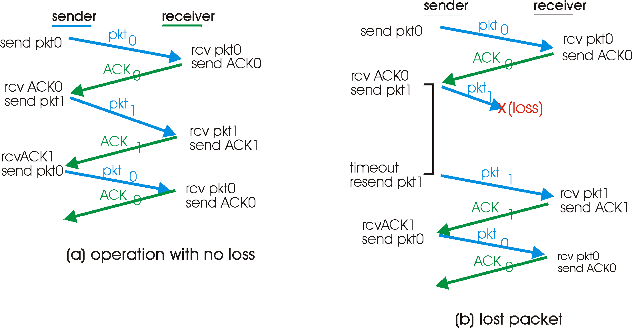
rdt3.0 in action

Slide 33
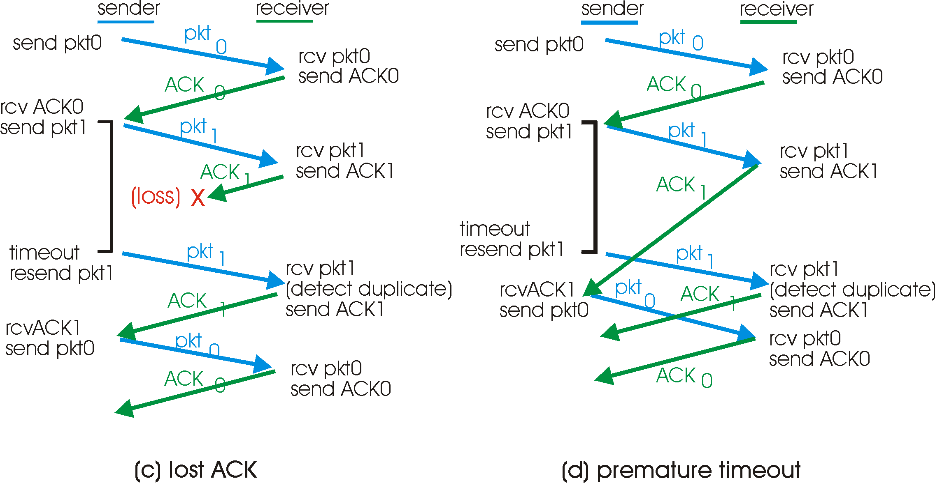
rdt3.0 in action

Slide 34
Performance of rdt3.0
rdt3.0 works, but performance stinks
example: 1 Gbps link, 15 ms e-e prop. delay, 1kB packet:
T
=
L (packet length in bits)
8kb/pkt
transmit
=
= 8 microsec
R (transmission rate, bps)
10**9 b/sec
U _{sender}: utilization – fraction of time sender busy sending
1kB pkt every 30 msec -> 33kB/sec throughput over 1 Gbps link
network protocol limits use of physical resources!
RTT : round trip time (propagation delay).

Slide 35
rdt3.0: stop-and-wait operation
sender
receiver
first packet bit transmitted, t = 0
last packet bit transmitted, t = L / R
first packet bit arrives
RTT
last packet bit arrives, send ACK
ACK arrives, send next
packet, t = RTT + L / R

Slide 36
Section outline
Transport-layer services
Principles of reliable data transfer
Primitives.

Slide 37
Transport service primitives.
A transport level protocol is implemented through the transport service primitives.
The transport service primitives allow transport service users (e.g. application processes) to access the transport service.
E.g. The socket primitives used in Berkeley UNIX for TCP:
Primitive | Meaning
SOCKET | Create a new communication end point.
BIND | Attach a local address to a socket.
LISTEN | Announce willingness to accept connections; give queue size.
ACCEPT | Block the caller until a connection attempt arrives.
CONNECT | Actively attempt to establish a connection.
SEND | Send some data over the connection.
RECEIVE | Receive some data over the connection.
CLOSE | Release the connection.

Slide 38
TCP segment structure
32 bits
URG: urgent data
(generally not used)
counting
by bytes
of data
(not segments!)
source port #
dest port #
sequence number
ACK: ACK #
valid
acknowledgement number
head
len
not
used
U
Receive window
A
P
R
S
F
PSH: push data now
(generally not used)
# bytes
rcvr willing
to accept
checksum
Urg data pnter
RST, SYN, FIN:
connection estab
(setup, teardown
commands)
Options (variable length)
application
data
(variable length)
Internet
checksum
(as in UDP)

Slide 39
TCP Connection Establishment

Slide 40
Summary.
Aim of transport layer to provide efficient, reliable services to users.
Provides QoS requirements (QoS parameters).
Standard set of primitives.
Basic elements of transport protocol.

Slide 41
Summary TCP & UDP.
UDP provides connectionless, best-effort data transfer. It is a ‘no-frills’ protocol providing multiplexing and limited error detection. It is relatively immediate but has no congestion control.
TCP provides reliable connection oriented (end-to-end) data transfer. Acknowledgements and flow control provide powerful means to ensure reliable and controlled data transfer supporting the error control functions.(Congestion control is covered later).

Slide 42
Summary
The transport layer uses the services of the network layer to provide different characteristics of service (reliable data service, unreliable prompt(?) service..).
Primitives are used by upper layers to use the transport layer services.
Primitives are provided by the transport entity to provide a particular transport service.
The service implementer (e.g. application programmer) through using the primitives obtains access to the transport service.

Slide 43
Problems:
Describe why an application developer may choose to run an application over UDP rather than TCP.
Is it possible for an application to enjoy reliable data transfer even when the application runs over UDP?
True or False?
Host A is sending host B a large file over a TCP connection. Assume host B has no data to send A. Host B will not send acknowledgments to A because B cannot piggyback the acknowledgments on data.
Consider a TCP connection between host A and host B. Suppose that the TCP segments travelling from host A to host B have source port numbers x and destination port number y. What are the source and destination port numbers for the segments travelling from host B to host A?

Slide 44
In protocol rdt3.0 the ACK packets flowing from the receiver to the sender do not have sequence numbers (although they do have an ACK field that contains the sequence number of the packet they are acknowledging). Why is it that our ACK packets do not require sequence numbers?
Draw the finite state machine for the receiver side of protocol rdt3.0
Provide a trace of the operation of protocol rdt3.0 when data packets and acknowledgement packets are garbled. Your trace should be similar to those in slide 29 (of this course).
In both the server and client code provided in ‘Socket Programming.ppt’ there is a comment that the value of SERVER_PORT must be the same in both client and server. Why does this matter?
Explain the process of connection establishment using Berkely sockets primitives and explain how the TCP segment structure indicates this.

Slide 45
Transport protocols & congestion control
References
Computer Networks. A.S. Tanenbaum. 4th edition, Pearson Education, 2003. (Chapter 6)
Computer networking: A Top-Down approach featuring the Internet. J.F. Kurose & K.W. Ross. Addison Wesley. (Chapter 3)

Slide 46
Lecture content
User Datagram Protocol (UDP)
Transport Control Protocol (TCP)
Congestion Control Algorithms
Retransmission Timer
Flow Control
TCP over wireless networks

Slide 47
Learning outcomes
At the end of this lecture you should be able:
to discuss UDP characteristics
to describe UDP header fields
to describe TCP header fields
to show understanding of the 4 basic TCP congestion control algorithms
to understand the importance of congestion and flow control
to understand the different proposals to make TCP robust

Slide 48
Transport layer in IP/TCP reference model
Responsible for end-to-end communication between Internet hosts.
Supports both connection-oriented and connectionless communication modes.
At the sender: receives application data, fragments it, adds a header and pass it to the network layer.
At the receiver: receives IP packets, performs error detection, delivers data application to the corresponding process.

Slide 49
Internet & transport protocols
Currently the Internet uses two transport layer protocols for end-to-end communication: UDP and TCP.
UDP provides the basic services of multiplexing /demultiplexing and some error checking.
TCP is a complex protocol which has congestion and flow control mechanisms in order to provide a reliable data transfer service.
Request for Comments (RFC) documents are published by the Internet Engineering Task Force (IETF) for Internet protocols standardisation. http://www.ietf.org/
While RFC 768 describes UDP, different TCP versions are proposed in RFCs 793, 2018, 2581 & 3782.

Slide 50

UDP
The is the simplest transport layer protocol with an 8-byte header.
UDP header from [1]
16-bit ports are the end points (within the host) where the data or control message is sent/received from.
The Internet Assigned Numbers Authority (IANA) assigns port numbers (from 0 to 1023) to UDP & TCP. http://www.iana.org/

Slide 51
UDP
Two popular UDP ports numbers are: 21 for data transfer (FTP) and 25 for e-mail transmission (SMTP).
The UDP length field includes the 8-byte header, so…what is the maximum amount of application data that can be sent in an UDP datagram?
If it is possible to send that MUCH data, why is far less usually sent (i.e. around 1500 bytes)?

Slide 52
UDP
Checksum is optional and is performed over the data and a pseudo header which contains: the Length header and 3 fields from the IP header (the IP source and destination addresses as well as the Protocol field).
Why could performing the UDP checksum be considered a violation of the Internet protocol-layer policy?
As there is no connection set-up and the header is small, the processing time is faster. This makes UDP suitable for interactive or delay-sensitive applications (e.g. VoIP).

Slide 53
UDP
The inexistence of flow and congestion control allows an UDP flow to use as much bandwidth as it needs (if available in a link).
As it is connectionless, there is no guarantee that the data is received.
What would happen if…two different UDP processes (from two different sources) are delivering data to the same host and the destination ports are the same?

Slide 54
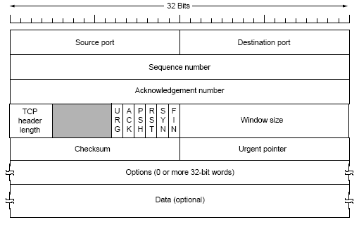
TCP
TCP, in contrast to UDP, provides mechanisms for flow and congestion control (which provide fairness in the sharing of a link when other TCP connections are used).
TCP header from [1]

Slide 55
TCP
The TCP header provides:
The 32-bit Sequence and Acknowledgement number fields are used by the congestion control algorithms.
Header length field indicates to the receiver where the data application starts…how?
Window size field is set by the receiver to announce how much buffer space is available for the current connection.
The Checksum field performs error detection over the data, TCP header and the pseudo header mentioned before.

Slide 56
TCP
Options field usually used for interchanging information about the maximum TCP segment that each process can manage (during connection set up).
Two limits on the TCP segment size are:
Maximum payload allowed by an IP packet (65495 bytes).
Each network has a maximum transmission unit, MTU, which is advertised in the IP header (e.g. Ethernet MTU=1500 bytes and this is the commonest Internet MTU size).
At the beginning of the connection, TCP chooses a random sequence number to start with….(why?)

Slide 57
TCP congestion control algorithms
TCP (as described in RFC 2581) has 4 congestion control algorithms:
1. Slow Start,
2. Congestion Avoidance,
3. Fast Retransmit,
4. Fast Recovery.
The variable ‘Congestion window’ (CongWin) is a TCP state variable which limits the amount of data in bytes send by the TCP sender every round-trip time (RTT).
A timeout occurs when a TCP sender does not receive any feedback from the receiver, i.e. no acknowledgements (ACKs) for a certain period of time.

Slide 58
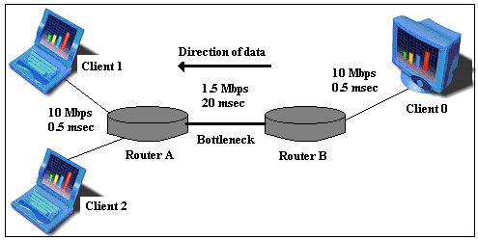
TCP congestion control algorithms
After a timeout, the TCP sender assumes that the segment is lost due to congestion and retransmission is needed.
But why do we need congestion control at all? When and where does congestion occur and what’s the problem?

Slide 59
1. Slow Start
After connection setup, the sender transmits 1 TCP segment. Once the ACK of these bytes is received, TCP increases the CongWin by the previous CongWin size. So that, twice the number of segments are sent (i.e. 2 x CongWin).
TCP continues doubling its CongWin as long as it receives the corresponding ACKs or the Receive window field allows it (when flow control would then be acting).
Slow Start finishes when the CongWin reaches a threshold or reaches the Receive window value.
The threshold value is usually 64 KB or half the previous CongWin value before a previous timeout.
This algorithm is implemented at the beginning of a TCP connection or after a timeout.

Slide 60
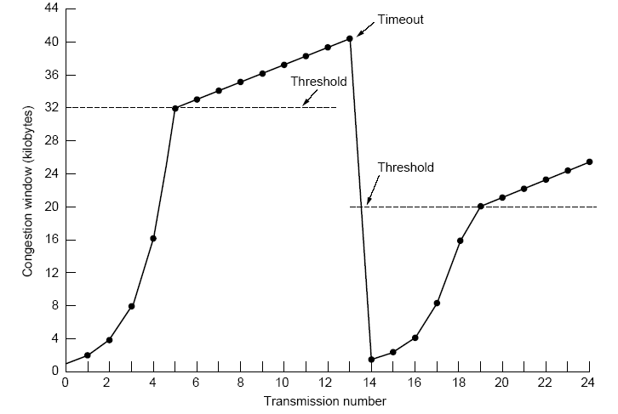
1. Slow Start
Threshold= 32 kB
TCP segment size=1 kB
CongWin size before timeout=40 kB
CongWin after timeout=1 TCP segment
Threshold after timeout=20 kB.
Slow Start and Congestion Avoidance from [1].
CongWin = 2^(no. of RTT) → CongWin in segments for Slow Start

Slide 61
2. Congestion Avoidance
Congestion Avoidance starts as soon as the CongWin reaches the ‘threshold’.
If no congestion occurs, the sender increases the CongWin by one TCP segment each RTT.
CongWin increment rate= (1/segments in the previous CongWin)
CongWin keeps growing until TCP finishes transferring the application or it is equal to the Receive window.

Slide 62
2. Congestion Avoidance
Reminder:
The Sequence number field is the first byte of data sent; while the Acknowledgement number field it is the last byte of data received plus one (i.e. the next byte of data expected).

Slide 63
3. Fast Retransmit
It is used to avoid unnecessary retransmissions and/or waste of link bandwidth i.e. it cancels the SS phase under certain conditions.
If TCP sender receives three duplicate ACKs , it assumes that the next in-order packet expected by the receiver is lost.
Duplicate ACKs= ACKs with the same Acknowledgement field number.
TCP retransmits only the packet which is being expected according to the duplicate ACKs.
TCP knows that the network is just slightly congested by receiving the three-duplicate ACKs …why?

Slide 64
4. Fast Recovery
After Fast Retransmit, the transfer of data is resumed. Instead of reinitialising with the Slow Start algorithm, Congestion Avoidance is implemented immediately.
In Fast Recovery, TCP cuts the CongWin by half.
Slow Start, Congestion Avoidance, Fast Retransmit and Fast Recovery

Slide 65
TCP congestion control
If the network is heavily congested, TCP would not receive any ACK of its current CongWin. Therefore, its retransmission timer will expire (a time-out).
In this case, TCP triggers Slow Start (not Fast Recovery) and sets the threshold to half of the last CongWin successfully received.
Finally, it retransmits the next segment after the last successfully acknowledged segment.

Slide 66
State | Event | TCP sender congestion-control Action | Comment
Slow start (SS) | ACK receipt for previously unacknowledged data | CongWin = ConWin + MSS, If (CongWin > Threshold) set state to “Congestion Avoidance” | Resulting in a doubling of CongWin every RTT
Congestion Avoidance (CA) | ACK receipt for previously unacknowledged data | CongWin = CongWin + MSS.(MSS/CongWin) | Additive increse, resulting in increase of CongWin by 1 MSS every RTT
SS or CA | Loss event detected by triple duplicate ACK | Threshold = CongWin/2, CongWin = Threshold, Set state to “Congestion Avoidance” | Fast recovery, implementing multiplicative decrease. CongWin will not drop below 1 MSS
SS or CA | Time-out | Threshold = CongWin/2, CongWin 1 MSS, Set state to “Slow start” | Enter Slow start
SS or CA | Duplicate ACK | Increment duplicate ACK count for segment being acknowledged | CongWin and Threshold unchanged
TCP sender congestion control (RFC2581).

Slide 67
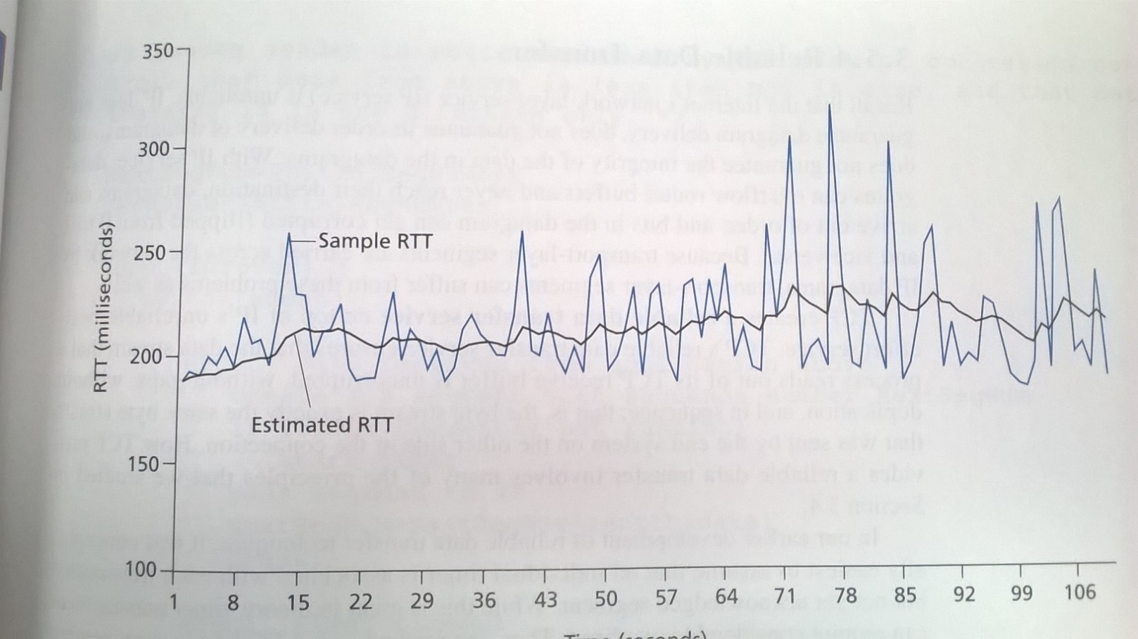
TCP retransmission timer (RFC 2988)
Need to decide how longs the ‘timeout’ should be.
Starting point is > RTT
Knowing the variation in RTT can help us decide how much greater than RTT.
Time (seconds)
Notes:
RTT Measurement/TCP Timers
Inorder for us to detect undelivered segments we need timers to determine if a ‘timeout’ has occurred.
We can’t expect ACKs to come back in less than the RTT so we need to set the Timeout period >RTT. But how do we determine the RTT?
-RTT will vary (depending on congestions (which will vary at routers), varying load and processing in end routers, different routes maybe, other flows (which will stop and start).
-we want timeout period > RTT so we don’t get unnecessary retransmissions but if it is too great then excessive delay will occur. Main cause of timeouts will be packet oss at routers due to congestion. If timeout is too short and so unnecessary retransmissions occur this will aggrevate the congestion.
Step 1.
Estimate RTT. Sice t varies we want to take an average somehow (i.e. smooth it). TCP measures the RTT of successfully acknowledged segments, R.
Smoothed_RTT = (1-a)Smoothed_RTT + a.R
i.e. We’re calculating smothed_RTT weighted by current measured RTT, R and previous samples.
{Having got a smoothed RTT, S_RTT, the Internet/TCP initially just used TimeOut=2xS_RTT but development determined that hving the multiplier proportionate to te variance of S_RTT gave better performance.}
Step 2.
So now we have obtained a smoothed RTT it is useful to have a measure of the varience i.e. the amount it varies as this indicates if our Smoothed_RTT is a reasonable estimate of particular RTT.
To achieve estimate of variation we calculate difference between R (Sampled RTT) and Smoothed_RTT and take a smoothed version of this!:
RTTVar= (1-b)RTTVar + b|SRTT-R|
Other.
Determination of a and b is non-trivial.
Normally (in TCP) a-1/8 and b=1/4 (RFC 2988)
(Values partly chosen for implementational efficiency)
So we have SRTT and RTTVar, what about TimeOut period? (RTO)
RTO = SRTT + 4*RTTVar
(G to allow for granularity of clock)
If we get a timeout then timeout doubles since we are now in congestion.

Slide 68
TCP retransmission timer (RFC 2988)
TCP uses retransmission and timeout mechanisms to recover from losses.
At the beginning of a TCP connection, when the first RTT measurement R is made, these variables are set to:
where:
SRTT= Smoothed Round-Trip Time
RTTVAR= Round-Trip Time Variation
RTO= Retransmission timer timeout

Slide 69
TCP retransmission timer
When a subsequent RTT measurement R’ is made:
α and β are smoothing factors that determine how much
weight is given to the old value [1].
The timer back off expression is:
The timer is doubled until it reaches a limit time (usually 60 sec).

Slide 70
TCP flow control
The Receiver window field in the TCP header helps to provide this service. This field maintains a count of the amount of buffer space currently available in the receiver. Thus it avoids TCP from sending more data that the receiver can handle.
Nagle’s algorithm tries stopping the sender application to deliver only one byte of data to the network.
Clark’s algorithm prevents the receiving application from sending rwnd updates of 1 byte.

Slide 71
TCP flow control
These two algorithms are complementary. One is dedicated to the sender and the other to the receiver but both have the same objective: to use the network bandwidth more efficiently and to increase the throughput of the application per RTT.

Slide 72
TCP features
TCP provides fairness when sharing a link with other TCP connections.

Slide 73
TCP features
TCP guarantees a reliable end-to end connection, so the application can be sure that its data will arrive at the intended receiver otherwise TCP will inform it about the failed connection.
TCP retransmissions are unacceptable for interactive applications (since the delay causes problems for the user).
Common applications using TCP as the transport layer protocol are the file transfer protocol (FTP) and web browsing (HTTP).

Slide 74
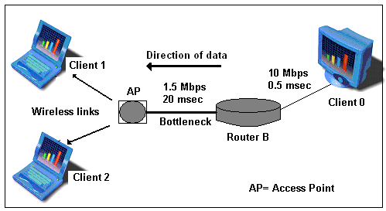
TCP over wireless links
TCP was designed and has been extensively optimised based on assumptions true for wired networks and therefore, it does not perform well in wireless networks.
What are these assumptions?? (Lost packets are due to congestion rather than propagation errors.)

Slide 75
TCP over wireless links
Proposed solutions:
- Introduction of intermediate network elements, e.g. TCP Snoop, Explicit Network Notification (RFC 3168).
-Adjustments of TCP settings (RFC 3481), e.g. use of TCP header timestamps options.
- Different TCP versions, e.g. TCP Westwood, TCP Peach, TCP New Jersey, TCP Veno….
-Link layer solutions, e.g. SR-ARQ protocol tries hiding channel losses through link-layer retransmissions.
Suggestions??

Slide 76
Summary
TCP is designed to provide a reliable end to end service but utilizing an unreliable network layer.
It provides congestion control which limits the amount of data sent in to the network.
It provides flow control which avoids over loading the receiver.
It provides reliable, in-order delivery, of all packets.

